Slide 1
Understanding Active Directory
Christopher Chapman | MCT
Content PM, Microsoft Learning, PDG Planning , Microsoft
Notes:
1 minute

Slide 2
Active Directory Domain Services
(AD DS)

Slide 3

Module Overview
Overview of AD DS
AD DS Physical Components
AD DS Logical Components

Slide 4
Lesson 1: Overview of AD DS
Protocol
What is Authentication?
What is Authorization?
Why Deploy AD DS?
Centralized Network Management
Requirements for Installing AD DS
Overview of AD DS and DNS
Overview of AD DS Components

Slide 5
Protocol
Lightweight Directory Access Protocol (LDAP)
X.500 Standard
Based on TCP/IP
A method for accessing, searching, and modifying a directory service
A client-server model

Slide 6


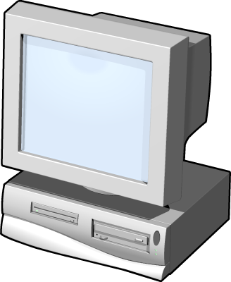
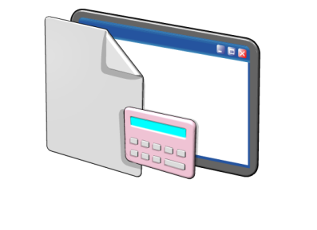
What is Authentication?
Authentication is the process of verifying a user’s identity on a network
Authentication includes two components:
Interactive logon: grants access to the local computer
Network authentication: grants access to network resources
Notes:
A passport is a good analogy for authentication. It is a means by which a user can verify they are who they say they are.
The most common way for users to authenticate is by providing a user name and password. However, some computer systems also support authentication based on smart cards, one-time passwords, or biometric information, such as fingerprint scans.

Slide 7








What is Authorization?
Authorization is a process of verifying that an authenticated user has permission to perform an action
Security principals are issued security identifiers (SIDs) when the account is created
User accounts are issued security tokens during authentication that include the user’s SID and all related group SIDs
Shared resources on a network include access control lists (ACL) that define who can access the resource
The security token is compared against the Discretionary Access Control List (DACL) on the resource and access is granted or denied
Notes:
Some of the types of attributes that might be contained in the security token are user group, ownership, and admin privileges.
The security identifier (SID) attribute is unique for each user or security group, and is the primary means by which the security principal is identified when trying to access network resources.
Authorization happens frequently and unobtrusively whenever users request services, like opening their home folder, reading/writing files, or when requesting access to an AD DS aware application. The user only sees the result of the authorization--they are granted or denied access.
An access control list (ACL) is a list of access control entries (ACE). Each ACE in an ACL identifies a security principal and the access rights allowed, denied, or audited for that principal. The security descriptor for a securable object can contain two types of ACLs: a DACL and a SACL.
A discretionary access control list (DACL) identifies the security principals that are allowed or denied access to an object. When a person or process tries to access an object, the system checks the ACEs in the object's DACL to determine whether to grant access to it. If the object does not have a DACL, the system grants full access to everyone. If the object's DACL has no ACEs, the system denies all attempts to access the object because the DACL does not allow any access rights.
A system access control list (SACL) enables administrators to log attempts to access a secured object. Each ACE specifies the types of access attempts by a specified principal that cause the system to generate a record in the security event log. An ACE in a SACL can generate audit records when an access attempt fails, when it succeeds, or both.

Slide 8
Why Deploy AD DS?
AD DS provides a centralized system for managing users, computers, and other resources on a network
AD DS features include:
Centralized directory
Single sign-on access
Integrated security
Scalability
Common management interface

Slide 9
Centralized Network Management
AD DS centralizes network management by providing:
Single location and set of tools for managing user and group accounts
Single location for assigning access to shared network resources
Directory service for AD DS enabled applications
Options for configuring security policies that apply to all users and computers
Group policies to manage user desktops and security settings

Slide 10
Requirements for Installing AD DS
Object | Description
TCP/IP | Configure appropriate TCP/IP and DNS server addresses.
Credentials | To install a new AD DS forest, you need to be local Administrator on the server. To install an additional domain controller in an existing domain, you need to be a member of the Domain Admins group.
Domain Name System )DNS) Infrastructure | Verify that a DNS infrastructure is in place. When you install AD DS, you can include DNS server installation, if it is needed. When you create a new domain, a DNS delegation is created automatically during the installation process. Creating a DNS delegation requires credentials that have permissions to update the parent DNS zones.

Slide 11


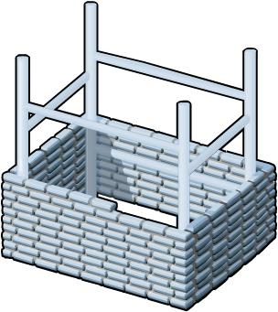




Overview of AD DS and DNS
AD DS requires a DNS infrastructure
AD DS domain names must be DNS domain names
DNS Domain Name
DNS
AD DS domain controller records must be registered in DNS to enable other domain controllers and client computers to locate the domain controllers
DNS zones can be stored in AD DS as Active Directory integrated zones
DNS Zone

Slide 12

Component Overview
AD DS is composed of both physical and logical components
Physical Components | Logical Components
Data store Domain controllers Global catalog server Read-Only Domain Controller (RODC) | Partitions Schema Domains Domain trees Forests Sites Organizational units (OUs)
Notes:
Physical components
Data store: Stores the AD DS information. This is a file on each domain controller.
Domain Controller Server and read-only domain controller (RODC): Contains a copy of AD DS database.
Global catalog servers: Host the global catalog, which is a partial, read-only copy of all the domain naming contexts in the forest. A global catalog speeds up searches for objects that might be attached to other domain controllers in the forest.
Logical components
Partitions: Various partitions exist in AD DS: domain directory, configuration directory, schema directory, global catalog, application directory.
Schema: Defines the list of attributes which all objects in the AD DS can have.
Domains: logical, administrative boundary for users and computers
Domain Trees: Collection of domain controllers that share a common root domain.
Forests: Collections of domains that share a common AD DS.
Sites: Collections of users, groups, computers as defined by their physical locations. Useful in planning administrative tasks such as replication of the AD DS.
OUs: Organizes the elements found at a give site or domain for the purposes of securing them more selectively.

Slide 13
Lesson 2: Overview of AD DS Physical Components
Domain Controllers
Global Catalog Servers
Data Store
Replication
Sites

Slide 14
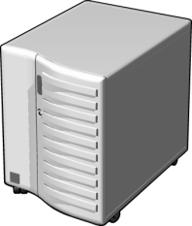

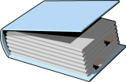
Domain Controllers
A domain controller is a server with the AD DS server role installed that has specifically been promoted to a domain controller
Domain controllers:
Host a copy of the AD DS directory store
Provide authentication and authorization services
Replicate updates to other domain controllers in the domain and forest
Allow administrative access to manage user accounts and network resources
Windows Server 2008 and later supports RODCs
Notes:
Each domain controller holds a copy of the directory store, and updates can be made to the AD DS data on all domain controllers except for RODCs.
Have multiple domain controllers in each domain. This provides load balancing, but more importantly, it also provides recoverability if a server failure occurs.
All domain controllers engage in authentication and authorization, thus making it a redundant system with fewer fail-points.

Slide 15


Global Catalog Servers
Global catalog servers are domain controllers that also store a copy of the global catalog
The global catalog:
Contains a copy of all AD DS objects in a forest that includes only some of the attributes for each object in the forest
Improves efficiency of object searches by avoiding unnecessary referrals to domain controllers
Required for users to log on to a domain
Notes:
The global catalog partition is like other partitions in AD DS, but unlike other partitions, administrators cannot enter information directly into this partition. The global catalog builds and updates its content based on values of a schema attribute (isMemberOfPartialAttributeSet), thus deciding when to replicate that attribute of an AD DS object in the global catalog.
Note that the alternative to having a searchable global catalog would be much more traffic over the entire organization’s network.

Slide 16
What is the AD DS Data Store?
The AD DS data store contains the database files and processes that store and manage directory information for users, services, and applications
The AD DS data store:
Consists of the Ntds.dit file
Is stored by default in the %SystemRoot%\NTDS folder on all domain controllers
Is accessible only through the domain controller processes and protocols
Notes:
The NTDS.DIT file is a database with usually 3 or more tables. The name and purpose of the important tables are the following:
1. datatable - used to store the objects accessible in Active Directory
2. link_table - used to provide references to objects (introduced with Server 2003)
3. sd_table - used to store the security descriptors
The database engine for NTDS.DIT is the Extensible Storage Engine (ESE or JET Blue) and is a proprietary Microsoft database engine. This engine is also used in Microsoft Exchange, however, the pagesizes are different between the two databases. It is 8192 bytes in the NTDS.DIT database and 4096 bytes in Exchange.
The AD DS database cannot be directly accessed by any applications. All access to the database is managed by the domain controller.
64-bit hardware can provide a significant performance boost for domain controllers because of the increase in addressable memory space.

Slide 17
What is AD DS Replication?
AD DS replication copies all updates of the AD DS database to all other domain controllers in a domain or forest
AD DS replication:
Ensures that all domain controllers have the same information
Uses a multimaster replication model
Can be managed by creating AD DS sites
The AD DS replication topology is created automatically as new domain controllers are added to the domain
Notes:
If directory information did not replicate regularly:
logons would fail at domains other than where the user account was created
locations and names of domain controllers might not be current, causing services contained on them to become unavailable
Advantages of multi-master replication include:
the elimination of single point of failure
faster replication as each domain controller can be involved with replicating data
Domain controllers in the same site replicate their data, typically within 15 seconds after a change, completing replication with all members in a properly configured tree in about 45 seconds.
When you create multiple sites, you can configure a replication schedule between the sites.

Slide 18
What are Sites?
An AD DS site is used to represent a network segment where all domain controllers are connected by a fast and reliable network connection
Sites are:
Associated with IP subnets
Used to manage replication traffic
Used to manage client logon traffic
Used by site aware applications such as Distributed File Systems (DFS) or Exchange Server
Used to assign group policy objects to all users and computers in a company location
Notes:
Sites are often defined after an analysis of network bandwidth capacity.
The primary reason for creating sites is to control network traffic across wide area network (WAN) links. By creating sites, you can minimize replication traffic across the WAN link because you can schedule the replication. You also control client logon traffic and provide a better client logon experience because client computers will always connect to a domain controller in their own site first.

Slide 19
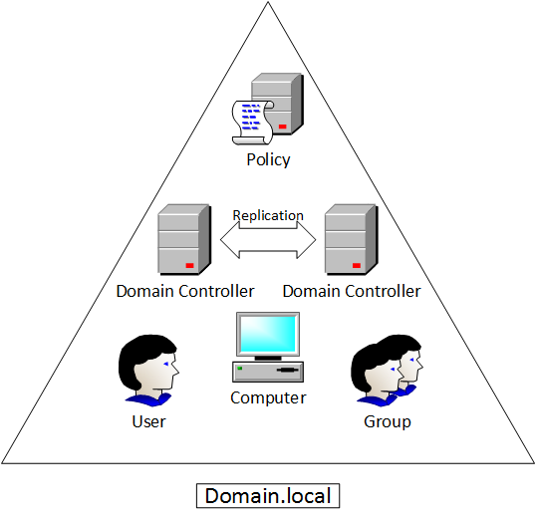
Domains
Units of Replication
Maintained by Domain Controllers
Millions of Objects
Notes:
All of the domain controllers in a particular domain can receive changes and replicate those changes to all other domain controllers in the domain. Each domain in Active Directory is identified by a Domain Name System (DNS) domain name and requires one or more domain controllers.

Slide 20
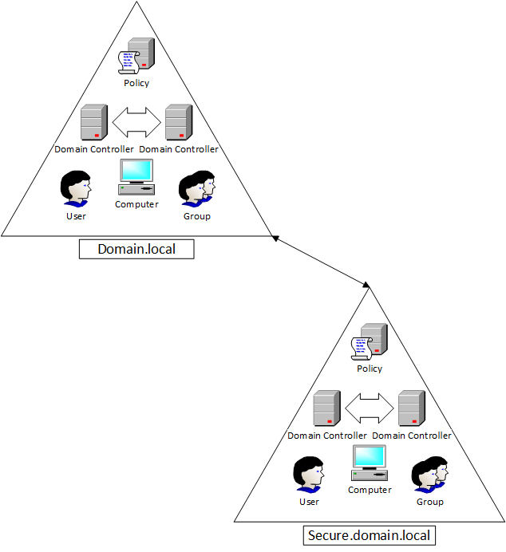
Trees

Slide 21
Lesson 3: Overview of AD DS Logical Components
AD DS Schema
The Basics
Trusts
AD DS Objects
Demo: Installation and Management

Slide 22
What is the AD DS Schema?
The AD DS Schema:
Defines every type of object that can be stored in the directory
Enforces rules regarding object creation and configuration
Object Types | Function | Examples
Class Object | What objects can be created in the directory | User Computer
Attribute Object | Information that can be attached to an object | Display name
Notes:
One of the easiest ways to describe the schema is to say that it is a set of rules that define what you can do in AD DS.
ADSIEdit and the Schema Management Console are tools you can use to manage the schema. You must register the Schema snap-in by using the regsvr32 schmmgmt.dll command before creating the custom MMC.

Slide 23

The Basics: Domains
Domains are used to group and manage objects in an organization
Contoso.com
Domains:
An administrative boundary for applying policies to groups of objects
A replication boundary for replicating data between domain controllers
An authentication and authorization boundary that provides a way to limit the scope of access to resources

Slide 24
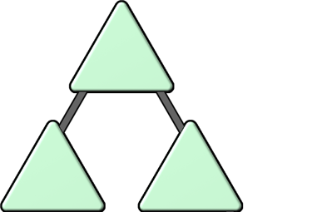
The Basics: Trees
A domain tree is a hierarchy of domains in AD DS
contoso.com
emea.contoso.com
na.contoso.com
All domains in the tree:
Share a contiguous namespace with the parent domain
Can have additional child domains
By default create a two-way transitive trust with other domains

Slide 25
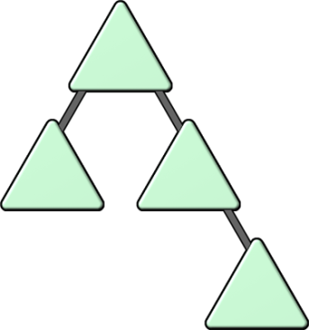
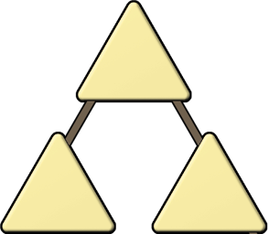
The Basics: Forests
A forest is a collection of one or more domain trees
Forests:
Share a common schema
Share a common configuration partition
Share a common global catalog to enable searching
Enable trusts between all domains in the forest
Share the Enterprise Admins and Schema Admins groups

Slide 26
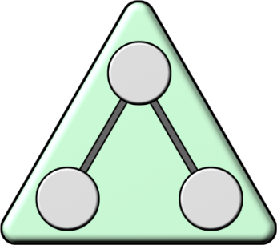
The Basics: Organizational Units (OUs)
OUs are Active Directory containers that can contain users, groups, computers, and other OUs
OUs are used to:
Represent your organization hierarchically and logically
Manage a collection of objects in a consistent way
Delegate permissions to administer groups of objects
Apply policies
Notes:
OUs can be used to create both a hierarchical and logical representation of a company. OUs can also be used to delegate certain administrative rights. For example, a junior network administrator may be given permission to administer user accounts in an OU that contains all accounts for a branch office location.

Slide 27


Trusts
Trusts provide a mechanism for users to gain access to resources in another domain
Types of Trusts | Description | Diagram
Directional | The trust direction flows from trusting domain to the trusted domain
Transitive | The trust relationship is extended beyond a two-domain trust to include other trusted domains
Access
TRUST
Trust & Access
All domains in a forest trust all other domains in the forest
Trusts can extend outside the forest
Notes:
The trusted domain as the domain where the accounts are, and the trusting domain as where the shared resources are.
Domains can allow access to shared resources outside of their boundaries by using a trust. You can use a one-way trust to optimize performance between domains. Mention that forest trusts allow users to access resources in any domain in the other forest, as well as logon to any domain in the forest using a same VPN.
Realm trusts enable trusts between Windows Server 2003 and Windows Server 2008 domains and directory-service implementations on other platforms by their shared use of open standard security system Kerberos version 5 protocol.

Slide 28
AD DS Objects
Object | Description
User | Enables network resource access for a user
InetOrgPerson | Similar to a user account Used for compatibility with other directory services
Contacts | Used primarily to assign e-mail addresses to external users Does not enable network access
Groups | Used to simplify the administration of access control
Computers | Enables authentication and auditing of computer access to resources
Printers | Used to simplify the process of locating and connecting to printers
Shared folders | Enables users to search for shared folders based on properties

Slide 29
DEMO: Installation and Management
Observe the installation of AD DS
Installation occurs without promotion to a domain controller
Domain Controller Promotion
Active Directory Users and Computers
Active Directory Administrative Center
Active Directory Sites and Services

Slide 30
Module Review and Takeaways
Review Questions
Summary of AD DS
Notes:
Review Questions
1. What are the three core partition types in an AD LDS instance?
Answer: The three main partition types are Schema, Configuration, and Application.
2. What ways are AD DS and AD LDS similar?
Answer: AD LDS and AD DS use the Extensible Storage Engine, enable LDAP client connections, use multimaster replication, and allow for delegated administration.
3. What tools are used to administer AD LDS and for what are each used?
Answer: Active Directory Lightweight Directory Services Wizard is used for creating new instances and new replicas of an AD LDS instance. ADSIEdit and LDP are used for viewing and modifying data. Ldifde and Csvde are used for importing and exporting data. Dsacls is used for viewing and setting permissions. AdamSync is used to synchronizing AD LDS and AD DS.
4. What are some reasons for deploying multiple AD LDS replicas?
Answer: Deploying multiple replicas can provide for high availability, load balancing, and geographic limitations.
5. How would you configure AD LDS if two applications required schema attributes that conflict with one another?
Answer: Because all application partitions in an AD LDS instance share a schema partition, the only way to provide multiple schemas is to deploy two instances of AD LDS, one for each application.
Summary of AD LDS
AD LDS is an LDAP directory service in Windows Server 2008. It provides data storage and retrieval for directory-enabled applications, without the dependencies that are required for AD DS.
AD LDS can have multiple writable replicas of the data on several servers. Having multiple writable copies eliminates the single point of failure. Replication provides high availability, allows for load balancing, and better serves geographically dispersed application access.
AD LDS and AD DS are similar because they both use an ESE database, enable LDAP client connections, use multimaster replication, and allow delegated administration. They provide different functionality as AD DS is an enterprise directory for administration and management, and AD LDS is a lightweight customizable solution for applications to use for authentication and data storage.

Slide 31
Thanks for Watching!

